Slide 1

PROGRAM YOGADAAN
To bridge the digital divide
Veeramachaneni Sri Sravya (IN010J79780)
Arunima Gupta (IN010J62977)
Maharshi Bhavsar (IN010J80858)
Unnat Bhavsar (IN010J52105)

Slide 2

Content
1
Program Overview
2
Alignment to EY’s ESG Goals
3
Solution Model - Process
4
Business Model
5
IBM Capabilities to be leveraged
6
Platform Technical Architecture

Slide 3
1. PROGRAM OVERVIEW
Program Context
YOGADAAN program is a global initiative that aligns to EY’s purpose of Building a better working world by contributing to the society, aligns to IBM’s Call for Code theme “Responsible production and Green consumption”. It aims to positively affect thousands of lives by:
solving one of the major societal challenge which is lack of resources to empower and educate the young people and underserved groups, and by
providing an opportunity to organizations of all scales in building/refining their strategy towards corporate responsibility as well as an opportunity for individuals to contribute to the society directly
According to “THE PRINT”, the education of ~16lakh students is disrupted due to lack of resources in the state of “DELHI”
Objective
Solving the societal challenge by removing hinderance in pursuing one’s dreams due to unavailability of electronic devices/resources
Beneficiaries: Those in need of electronic devices (like laptops, headsets, etc.) for pursuing education or earning livelihood and are not able to afford one
Donors: Individuals or corporates who wants to contribute to the larger cause and support the one in need directly
Impact
Help 67 million students in need of laptops and smartphones to continue education in India
Reduce e-waste of approx. 7,200 tons every year by re-utilisation of e-products, as India ranks 3rd highest in generating e-waste. Computer equipment accounts for 70% of e-waste, followed by phones (12%).
According to “NCERT” more than
27%
students in schools do not have access to smartphones or laptops to attend online classes

Slide 4



2. ALIGNMENT TO EY’s ESG GOALS
Objective
How it contributes to ESG Goals of EY
The main objective of this platform is to connect the corporates, individuals, MNCs who have used IT equipment’s such as laptops, mobiles etc. and are willing to donate the same to the needful students or underserved people
Environmental
Electronic products make up million tons of waste in landfills
Improper disposing the used IT equipment's would increase e-waste which in turn would release toxic chemicals, causing air pollution
Donating the used equipment to the needy students would help EY create long term impact of each purchase in a sustainable manner
Social
Donating the used equipment to the needy would align with the social aspect of the ESG goals by linking to the resource efficiency, social responsibility and economic resilience

Slide 5



3. Solution Model - Process
Marketeer who ensures foot fall of donors and drives new engagements
P2P Intermediary Platform
Fills application form for resources describing the need
Reviews application and approves need of a beneficiary
IBM NLP capabilities based screening of application form and suggestions
Individual Donor
Beneficiary
Fills in quality checklist of device (uploads images, device details)
Website platform development/ maintenance managed by program team
Gives device directly –
In-Person Meets
The inventory and logistics will be managed by the program team
Aid Partners
Device Inventory
Shipped through courier partner
Donates devices in Bulk to the platform
NGOs, educational institutes help our resources reach the beneficiary
If devices are not donated, after a certain timeframe are sold as scrap
Corporate Donor
Courier & Shipping Partner
Donate funds to aid laptop upgradation, accessories and other peripherals

Slide 6



4. Business Model
Growth & Impact Strategy of Program
MARKETING
To ensure footfall, encourage individuals and organizations to contribute for the cause
FUND RAISING
To run our program and provide added value to beneficiaries in terms of laptop accessories and other peripherals
AD REVENUE GENERATION
To support maintenance of our platform by paying hosting and cloud costs
HOW
Any individual who is in need of additional assets such as laptop accessories and other peripherals can start fund raising on the platform by updating necessary supporting documents
The campaign can be shared on different social media platforms
Advertising on website
Advertisers can target a wide audience from different societal structures and languages.
Website earns revenue based on clicks on the advertisement.
Channel and digital marketing
Tie ups with organizations at all scales
Through NGOs, Educational institutions
Costs affiliated to Program
Performance Measures of Program
Website platform development and Maintenance
Operational such as salaries to program FTEs, storage rental costs, logistics, marketing, misc. etc.
User acquisition cost
Shipping costs between YOGADAAN to NGOs or other partners
Adoption rate
Transaction amount
# of donors and receipts on the platform
# of successful donations
# of fund raisings on the platform

Slide 7
5. IBM Capabilities to be leveraged
Service | Purpose
IBM VPC | To create own protected space in IBM cloud along with security group & network access control list(ACLs) - Provides complete control over resource placement, networking and security
Cloud Object Storage | To serve static files (product images, advertisements, videos etc.)
Content Delivery Network | To cache content on the edge server closest to user’s geographic location - Provides faster load time across different regions ensuring best online experience - Helps to prevent a site crash in traffic surges - Decreases costs due to traffic offloading
IBM Cloud Kubernetes services | To create scalable compute cluster to deploy containerized applications - Makes application independent from underlying infrastructure - Reduce cost of infrastructure needed to run different applications
DB2 | To store transaction and inventory data in scalable and resilient manner - Used to store user details, payment transaction details, product specifications & inventory records
Language Translator API | To communicate with our end-users in local language - Helps to overcome language barrier between the beneficiary and the donor
Watson Natural Language Understanding | To classify beneficiary application whether it is genuine or not - Helps to grant authenticity to beneficiary. - Possibly identify plagiarism or machine generated text

Slide 8
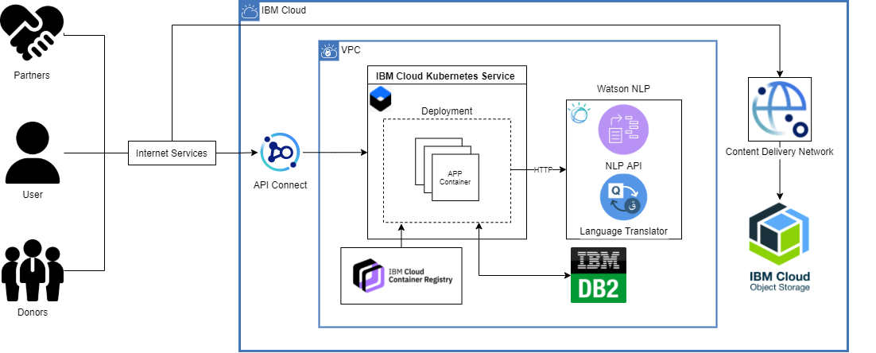
6. Platform Technical Architecture

